Slide 1
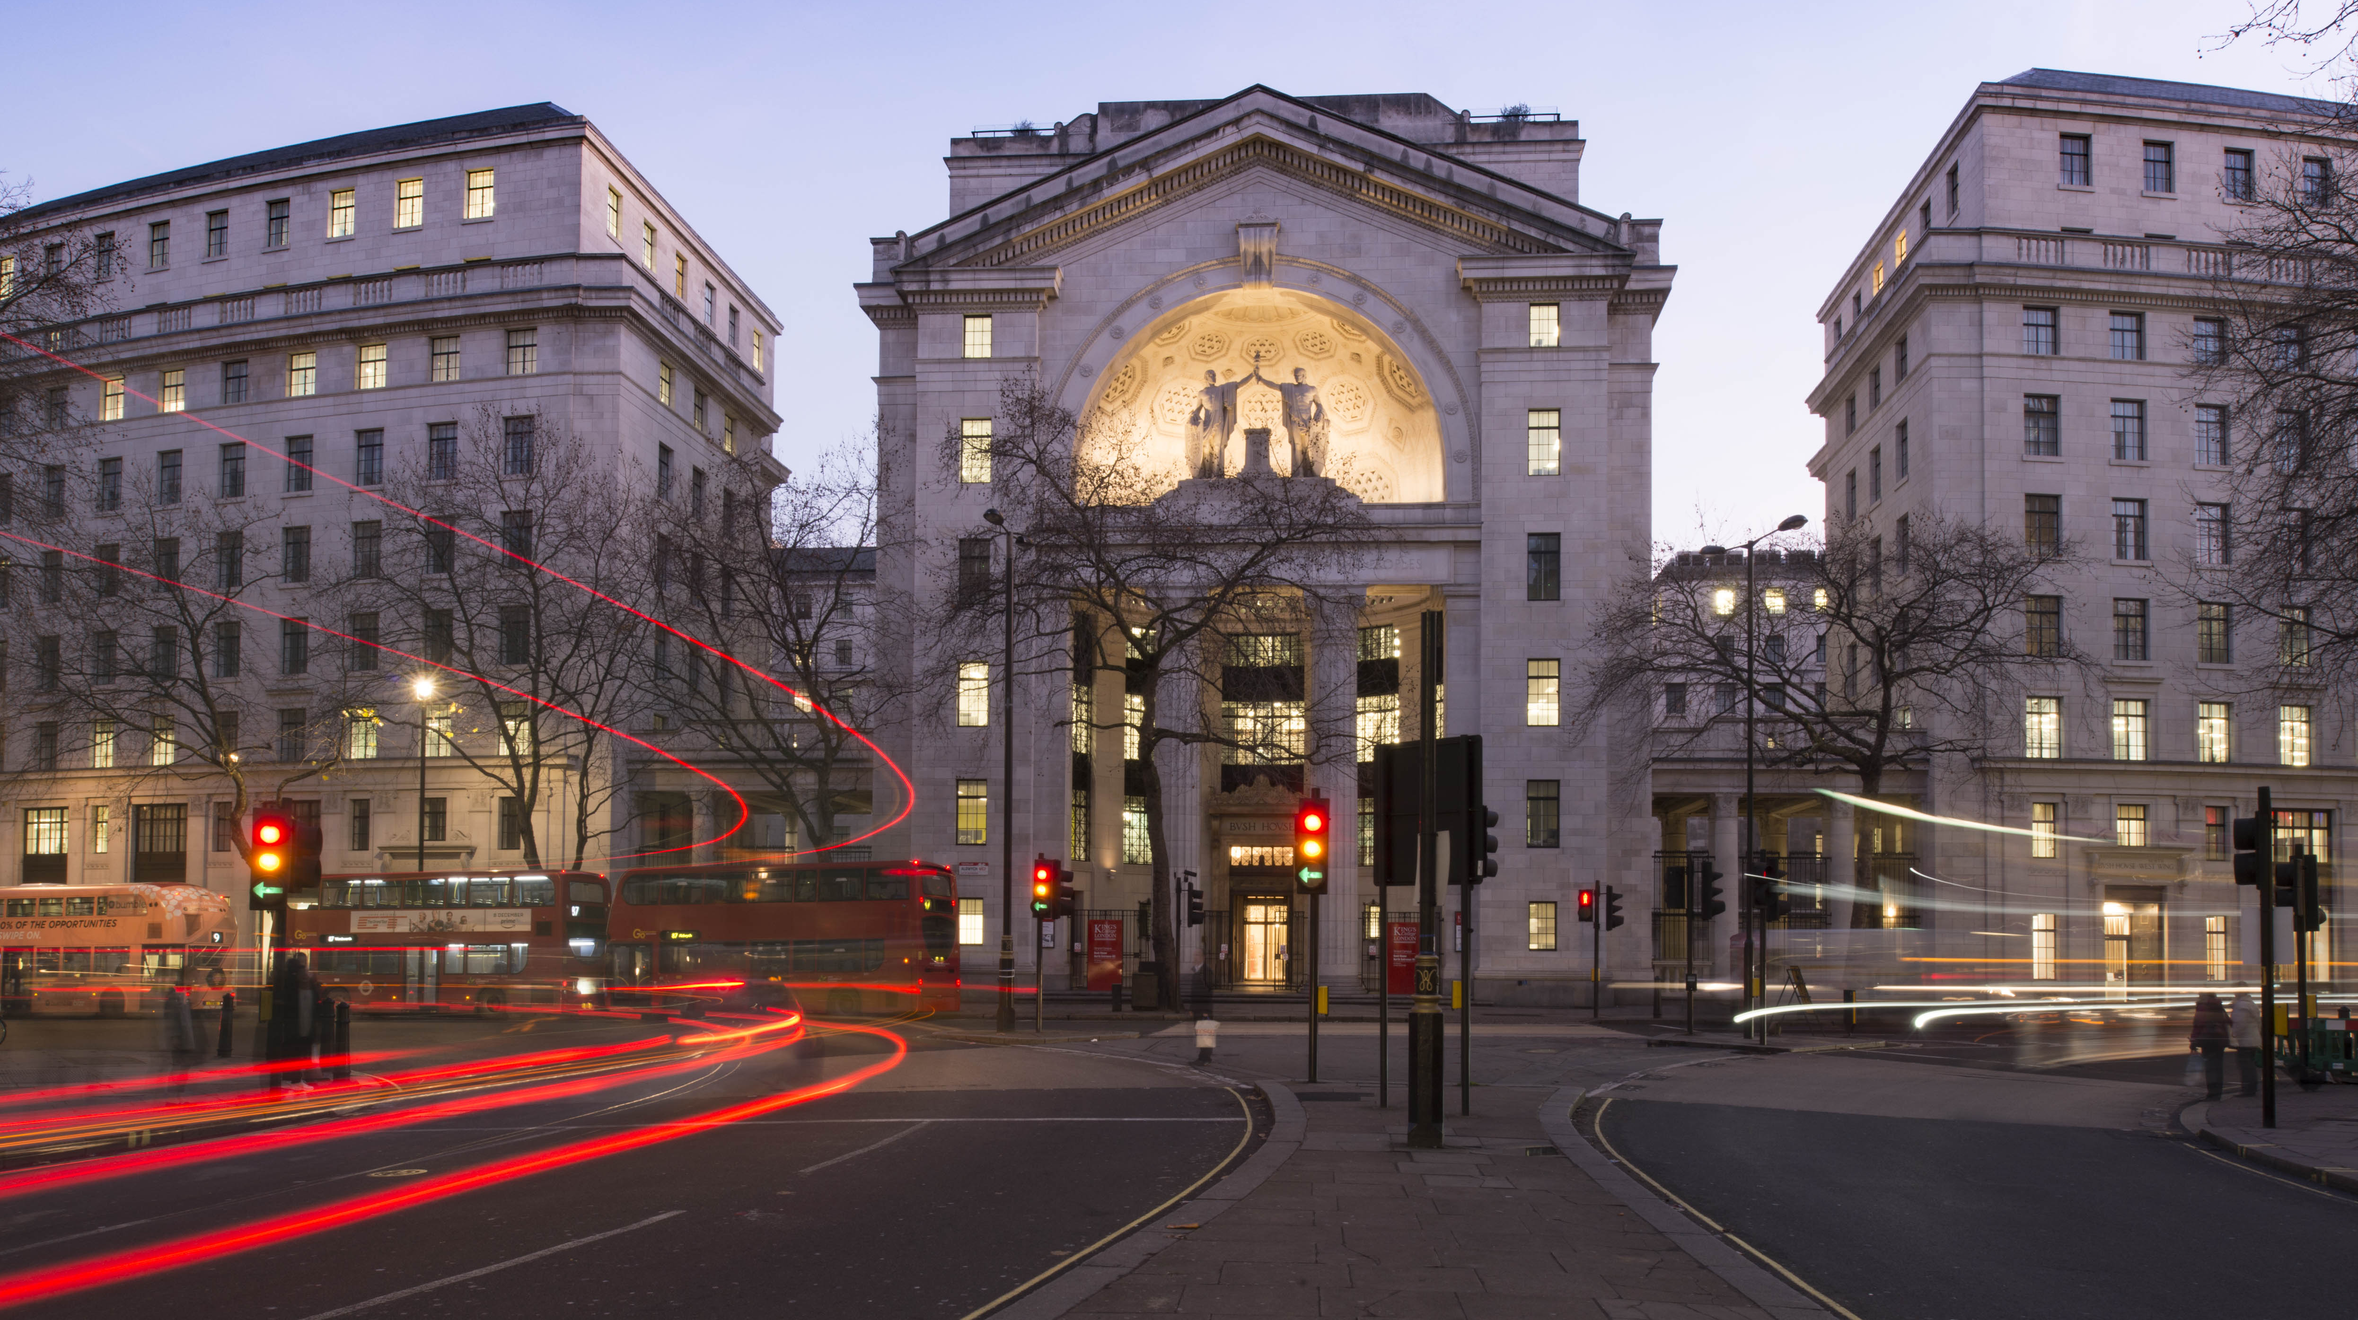

Rosalyn Moran
Department of Neuroimaging,
IOPPN
King’s College London
MODELING CONNECTIVITY:
DCM for EEG
WORKSHOP
16809/2021, ETH Zurich
Computational Psychiatry Course 2021

Slide 2
Summary of Analyses
Pre-Processing
Band-pass filtering (2-30 Hz)
Epoching (-52-500ms PST)
Artefact correcting
Source Identification via 3D source reconstruction
Dynamic Causal Modelling
Bayesian Model Selection
Further Analyses, e.g. Parametric Empirical Bayes
Determine parameters associated with task performance, disease state, on the group level

Slide 3
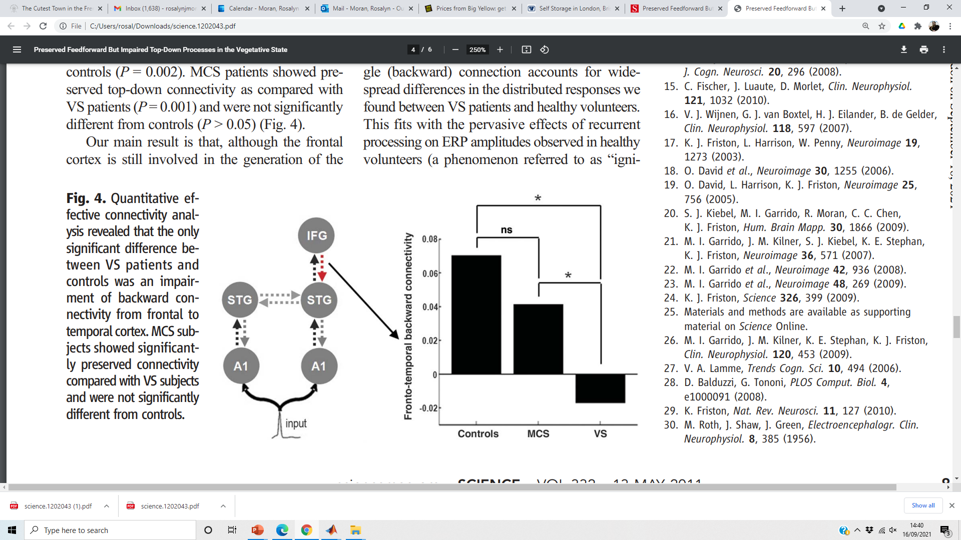
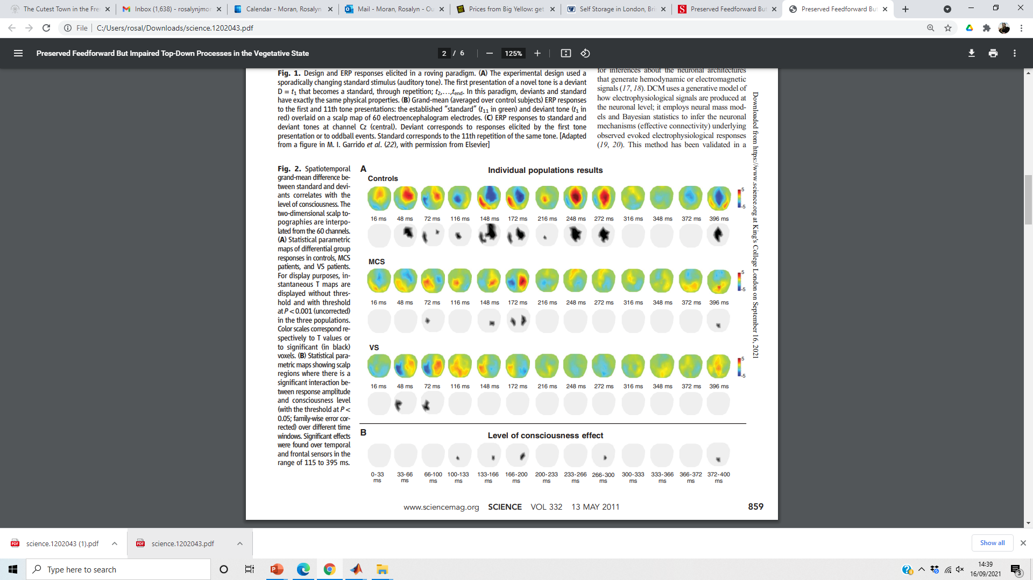

MMN in consciousness research

Slide 4
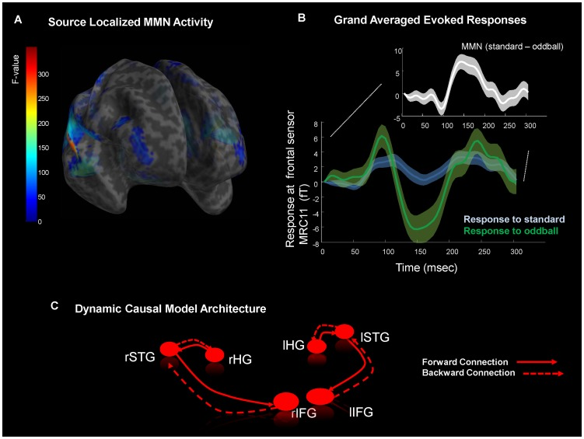
The MMN

Slide 5
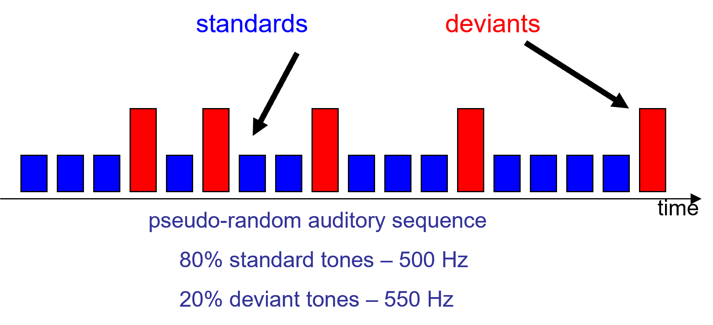
Mismatch negativity (MMN) paradigm and hypothesis
Hypothesis
MMN is caused by recurrent dynamics enabled by backward connections
Paradigm

Slide 6
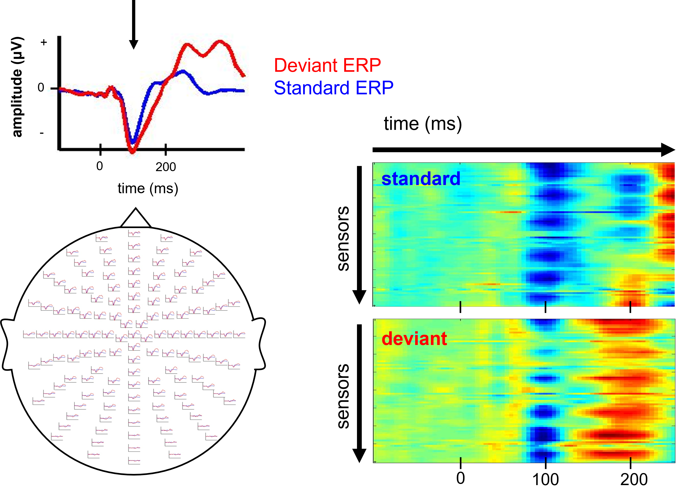

Slide 7
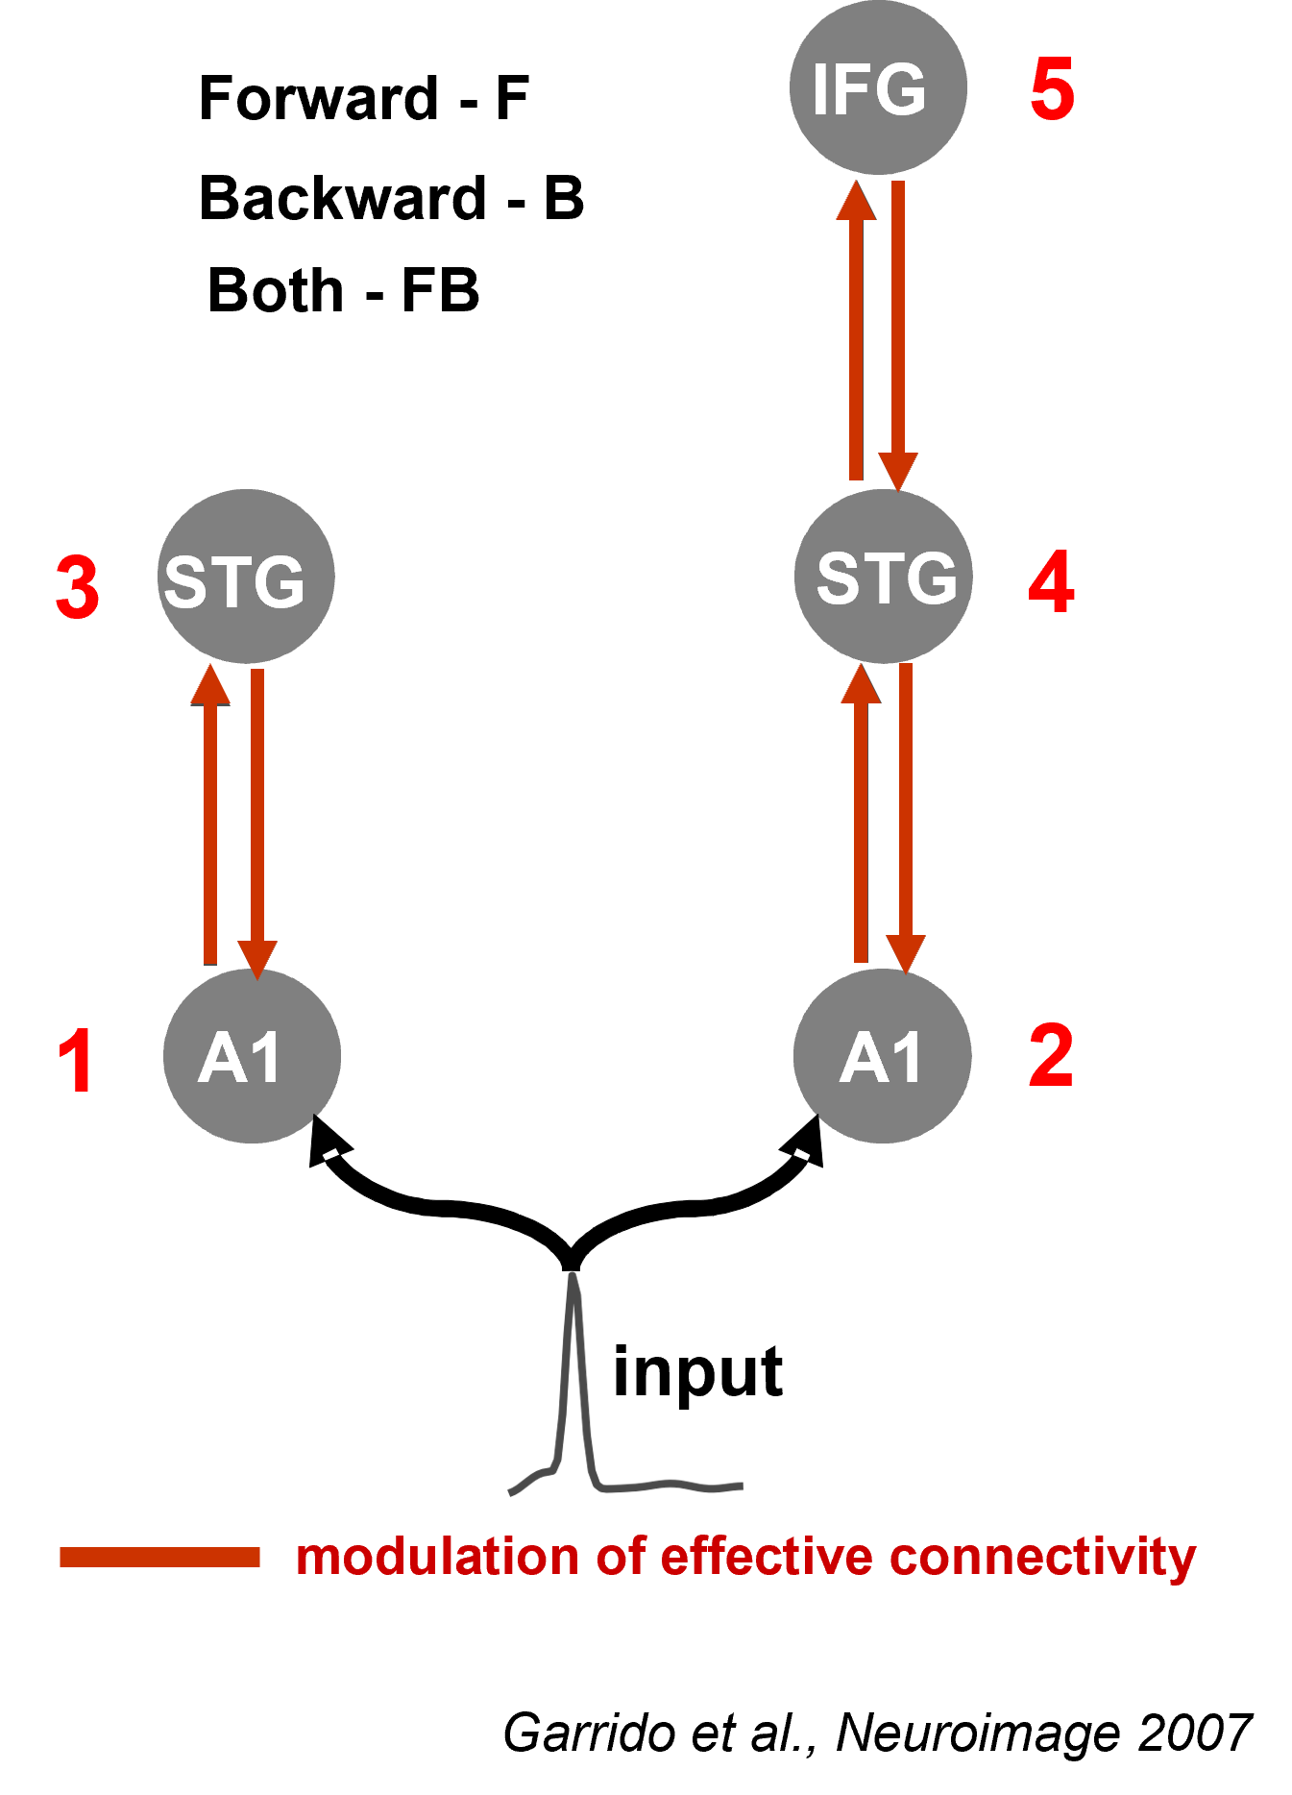

Slide 8
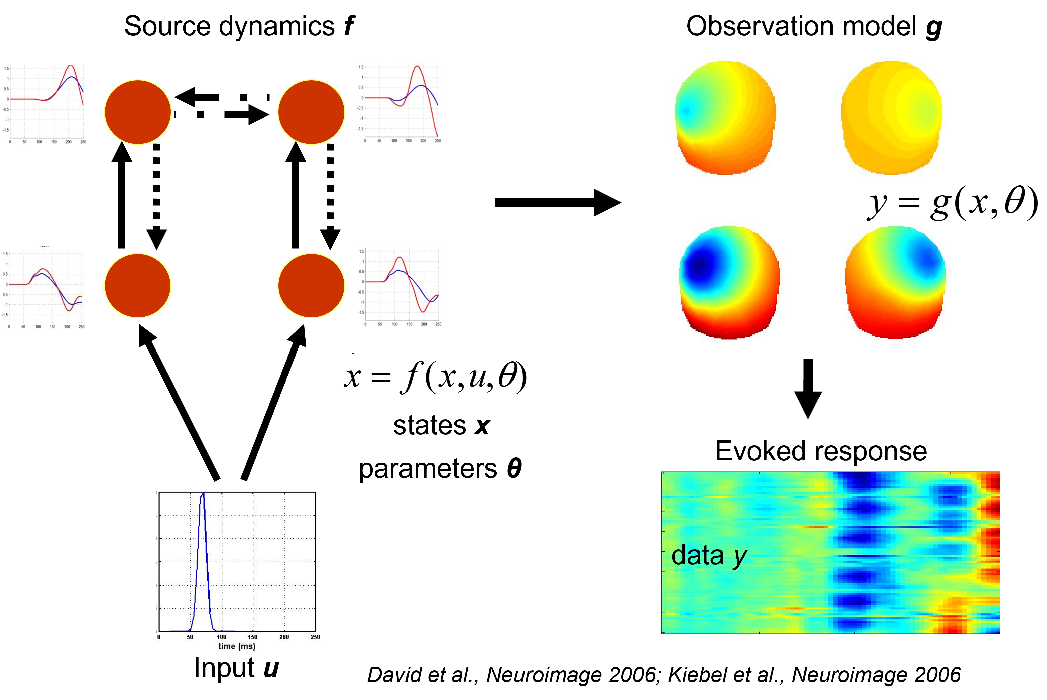
The Generative Model

Slide 9
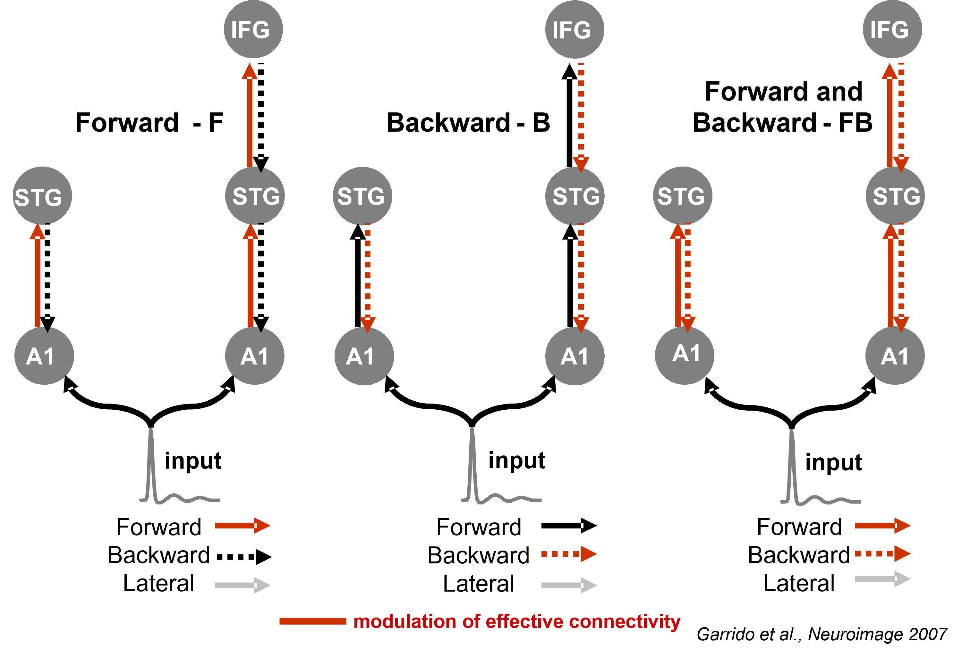

Slide 10
Analysis steps
Have a HYPOTHESIS!
Preprocessing and SVD decomposition
Model specification: specify cortical areas and inter-areal connections for various competing models that you think might explain your data
Model inversion: find the parameters that minimize differences between observed measurements and model predictions for each of the competing models
Bayesian model comparison: make a statistical inference about which model best describes the data
Parameter Inference

Slide 11

Tasks
1. Build a Backward Only DCM
1
2. Compare the CMC and ERP models.
2
3. Test that backward connections are more important for stimulus processing after 150 msec
3

